Slide 1
ATLIQ Electric Vehicle Project

Slide 2
AtliQ Motors INTRODUCTION
Current Status in USA
Atliq Motors is an Automotive Giant in USA in EV Sector and market share rose to 25% in last 5 Years.
Goal
They wanted to launch their bestselling models in INDIA where their market share less than 2%.
Strategy in INDIA
Bruce Haryali CEO of Atliq Motors in INDIA wanted to do a detailed market study of EV Status in INDIA.
Data Insights
Bruce gave EV Status in India task to Data Analyst team of Atliq Motors. I as as Data Analyst visualize all the insights.

Slide 3
Datasets
01
Dim_Date
We have data from 1st April 2021 to 1st March 2024. So from last three years staus of EV sales trend in INDIA.
02
Electric Vehicles Sales by Maker
In this Data set we have Date, Makers Name and Electric Vehicle sold qty. From here we get idea which maker is more active in INDIA.
03
Electric Vehicles Sales by State
In this Data set we have Date, State Name, EV sold qty and Total vehicle sold qty. From here we get idea in which state penetration rate and CAGR is high.

Slide 4
Primary Agenda’s
Top and Bottom 3 Makers in EV Sold for 2 Wheelers
1
2
States with highest and negative penetration rate.
Quarterly and PEAK and LOW Season trend of EV Sales Volume by Makers
3
4
Delhi and Karnataka EV Sales and Penetration rate comparison
CAGR of Top 5 makers and Top 10 States
5
6
Projected EV Sales till 2030 and Revenue Growth

Slide 5
Secondary Agenda’s
Primary Reasons customer choosing 4 Wheelers.
1
2
Govt. incentives and subsidies impact the adoption rate
Charging Station infra. Correlate to EV Sales and Penetration
3
4
Who should be the Brand Ambassador of AtliQ Motors in INDIA
Ideal state to start manufacturing unit
5
6
Top 3 Recommendations for AtliQ Motors

Slide 6
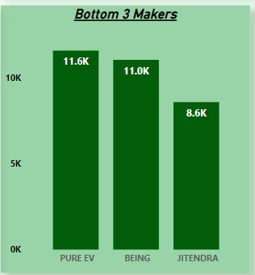
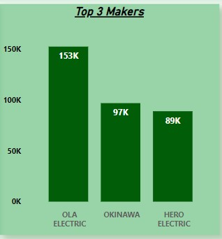
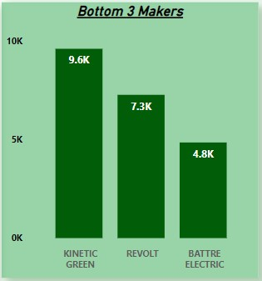
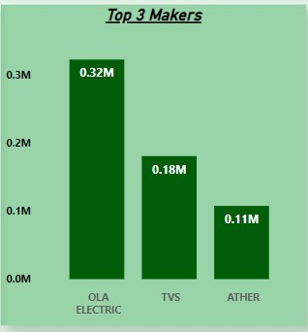
Top and Bottom EV Makers
Bottom 3 FY-23
Top 3 FY-23
Bottom 3 FY-24
Top 3 FY-24

Slide 7
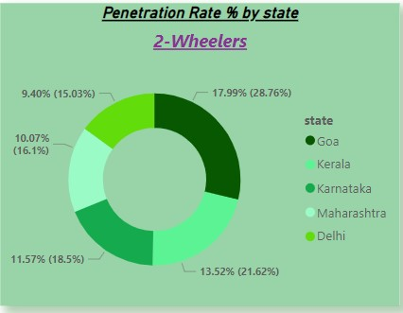
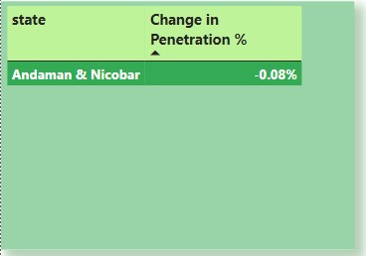
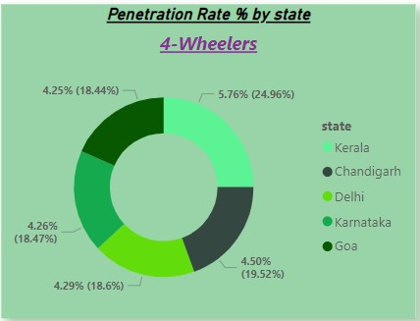
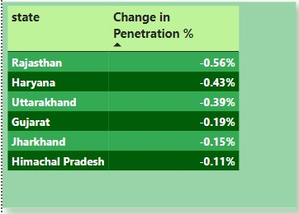
EV Penetration Rate in State
Top 5 State Penetration % by Vehicle Category
States with negative Penetration % FY-23 & 24
Goa, Kerala, Karnataka, Maharashtra, and Delhi hold the top 5 positions respectively in the 2-Wheelers segment. Meanwhile, Kerala, Chandigarh, Delhi, Karnataka, and Goa are the top 5 performers in the 4-Wheelers segment. This data clearly indicates that Goa, Kerala, Karnataka, and Delhi are consistently performing well across both the 2-Wheeler and 4-Wheeler segments.
For FY-23, Andaman & Nicobar was the only region with a negative penetration percentage. However, in FY-24, five states are now exhibiting negative penetration percentages. Rajasthan has experienced the most significant decline in EV sales, followed by Haryana and Uttarakhand.
FY-23
FY-24

Slide 8
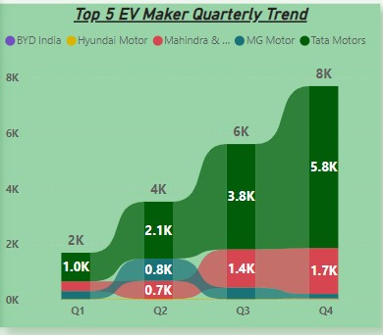
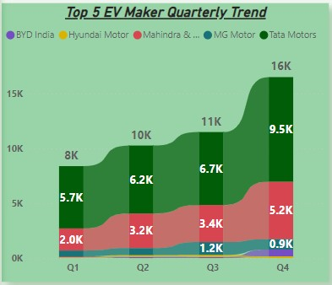
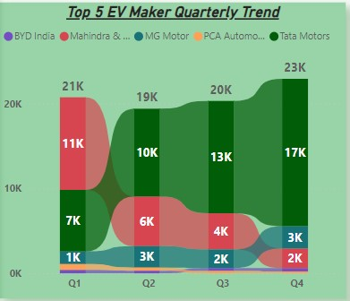
Quartely Trend of EV Sales by Makers 4 Wheelers Segement
For FY-22
For FY-23
For FY-24
From the Ribbon graphs, it is evident that Tata Motors maintained its top position in all quarters except for Quarter 1 of FY-24. In FY-22 and FY-23, the top 5 EV makers remained consistent. However, in FY-24, Hyundai was replaced by PCA Automobiles, which held the 4th position in Q1 and Q2 and dropped to 5th position in the remaining two quarters.

Slide 9
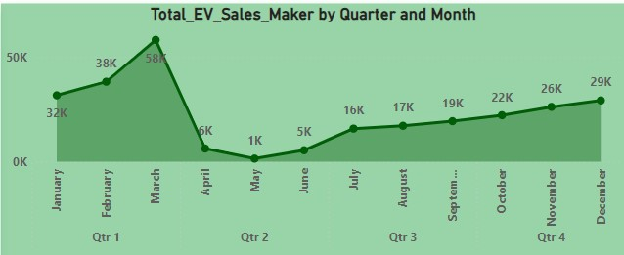
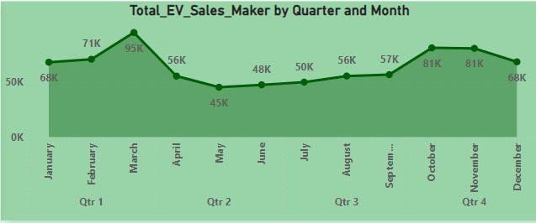
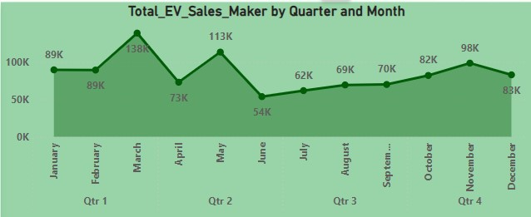
Peak and Low Season Month for EV Sales
FY-22
FY-23
From FY-22 to FY-24, March consistently emerged as the peak month for EV sales.
In FY-22, May marked the low season, followed by June and April. After peaking at 58K units in March, sales volume dropped significantly, bottoming out in June before gradually recovering to 29K units by December.
In FY-23, May was again the low season, but the sales decline was less severe compared to FY-22. Sales improved gradually after May, reaching 81K units in October, before dipping again to 68K units in December.
In FY-24, the trend shifted, with June becoming the low season at 54K units. Sales then picked up, peaking at 98K units in November, but dropped again to 83K units in December.
FY-24

Slide 10
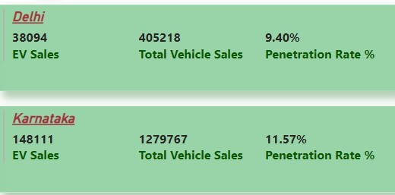
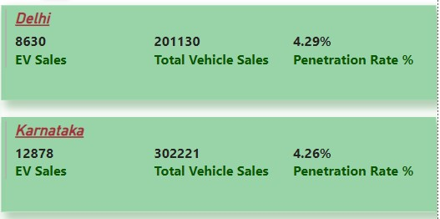
Delhi and Karnataka Comparison for FY-24
2 Wheelers
4 Wheelers
From the data above, it is clear that Karnataka leads in the 2-Wheelers segment. However, in the 4-Wheelers segment, while Delhi has a slightly higher penetration rate, Karnataka surpasses Delhi in EV sales volume by 4,000 units.

Slide 11
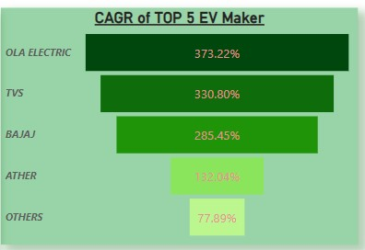
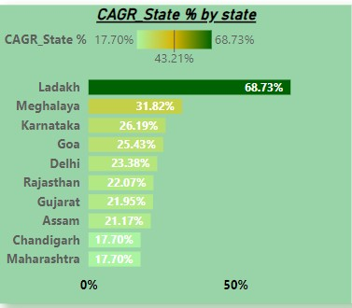
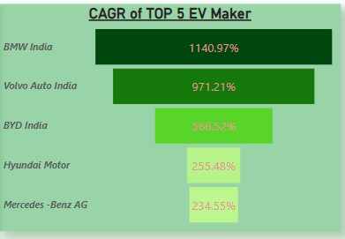
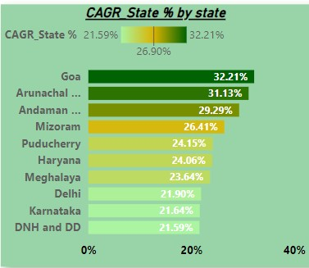
Compund Annual Growth Rate for Makers and States
2 Wheelers
2 Wheelers
CAGR measures the mean annual growth rate over a specified period longer than one year. It is calculated as:
CAGR = [(Ending Value / Beginning Value) ** 1/n] -1.]
In the 2-Wheelers segment, OLA Electric holds the top position, followed by TVS, Bajaj, Ather, and Others. In the 4-Wheelers segment, BMW India leads with a 1,141% CAGR, followed by Volvo with a 971% CAGR.
In the 2-Wheelers segment, Ladakh boasts an impressive CAGR of 68.73%, followed by Meghalaya and Karnataka. Maharashtra ranks 10th in this segment.
In the 4-Wheelers segment, Goa leads with a CAGR of 32.21%, followed closely by Arunachal Pradesh at 31.13%. Daman and Diu hold the 10th position.
4 Wheelers
4 Wheelers

Slide 12
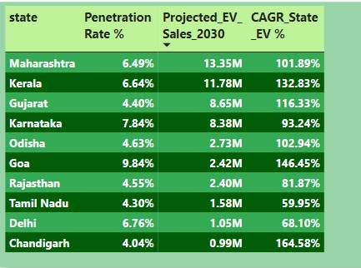
Projected EV Sales 2030 for Top 10 States
The left table indicates that Maharashtra is projected to lead in EV sales volume by 2030, followed by Kerala. However, in terms of penetration rate percentage, Goa is leading, with Karnataka in second place.
When it comes to CAGR percentage, Chandigarh holds the top position, followed by Goa and Kerala.

Slide 13
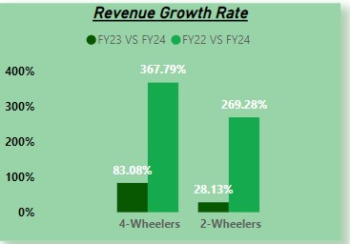
Revenue Growth of 2 Wheelers and 4 Wheelers FY22 v/s FY24 and FY23 v/s FY24
The bar graph above clearly shows that the revenue growth rate for FY22 vs. FY24 is 367.8% for 4-Wheelers and 269.3% for 2-Wheelers. For FY23 vs. FY24, the revenue growth rate is 83.1% for 4-Wheelers and 28.1% for 2-Wheelers.
This indicates that revenue growth for 4-Wheelers is significantly higher in both fiscal year comparisons.

Slide 14
Secondary Agenda’s
Primary reasons for customers choosing 4-Wheeler EVs in 2023 and 2024:
1.Environmental Concerns: Governments have introduced numerous policies aimed at reducing carbon footprints, and consumers are increasingly aware of their environmental impact. Additionally, many states have expanded the network of EV charging stations, making it easier for people to drive their EVs over long distances.
2.Cost Savings: EVs typically have lower fuel and maintenance costs compared to traditional internal combustion engine vehicles. While the initial purchase price may be higher, the lower total cost of ownership over time—including savings on fuel, tax benefits, and reduced maintenance—makes EVs an attractive option.
Government schemes and subsidies impact the adoption rate or EV’s-
Government incentives and subsidies play a crucial role in accelerating the adoption of 2-wheelers and 4-wheelers, particularly electric vehicles (EVs).
1.Lower Purchase Costs: Subsidies directly reduce the upfront cost of EVs, making them more affordable compared to traditional internal combustion engine vehicles. This is especially significant for 2-wheelers, where price sensitivity is higher among consumers.
2.Tax Benefits: Many governments offer tax rebates or reductions on EV purchases, further lowering the cost burden. This is an attractive proposition for both individual buyers and businesses, encouraging them to opt for EVs.
The combination of reduced costs, tax benefits, and ongoing incentives such as subsidies for charging infrastructure, leads to higher adoption rates.
The very first on our list is Gujarat, which offers a maximum subsidy of up to ₹20,000 on electric two-wheelers with no registration charges. Furthermore, the subsidy is up to ₹50,000 for three-wheelers. For electric four-wheelers, the state government offered a maximum benefit of up to ₹1.5 lakh.

Slide 15
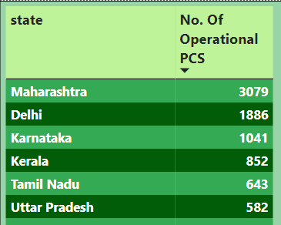

Secondary Agenda’s
Availability of charging stations infra correlate to EV sales and penetration rate-
We can easily conclude from the table below that states with sufficient charging infrastructure tend to have higher EV sales volumes and penetration rates. When people have easy access to charging stations, they are more likely to use their EVs for long drives without worrying about where to charge their vehicles.
Brand Ambassador of AtliQ Motors in India for EV/Hybrid Model-
Dia Mirza - Actress and Environmental Activist:
Why?: Dia Mirza is well-known for her environmental activism and her work as a UN Environment Goodwill Ambassador. Her involvement could emphasize AtliQ Motors' commitment to sustainability and responsible innovation. Her image aligns with eco-conscious consumers and those looking for brands that contribute positively to society.

Slide 16
Secondary Agenda’s
Top 3 Recommendation for AtliQ Motors-
1.Leverage Government Incentives and Collaborate with State Governments: India’s government offers various subsidies, tax incentives, and benefits for companies in the EV sector. By strategically setting up manufacturing units and operations in states like Gujarat, Maharashtra, and Tamil Nadu, AtliQ Motors can maximize these benefits.
2.Adapt Products to Indian Market Needs and Conditions:
The Indian market is diverse, with varying needs and preferences across regions. Products that succeed in India are those that are tailored to local conditions, such as climate, road infrastructure, and consumer purchasing power.
3.Invest in R&D and Local Manufacturing to Drive Innovation and Cost Efficiency:
Investing in research and development will allow AtliQ Motors to innovate in battery technology, vehicle design, and cost-effective manufacturing processes, which are critical to staying competitive in the rapidly evolving EV market.
Ideal Indian State to Start the manufacturing unit-
Gujarat stands out as one of the most favorable states in India for setting up a manufacturing unit, particularly for industries like electric vehicles (EVs) and hybrid vehicles. Here's why Gujarat is an ideal choice:
1. Attractive Subsidies and Incentives:
Gujarat offers one of the most comprehensive and generous EV policies in India. The state provides substantial subsidies for manufacturers setting up EV and related infrastructure projects.
2. Ease of Doing Business:
Gujarat consistently ranks high in the Ease of Doing Business index in India.
3. Stability in Governance:
Gujarat is known for its stable and business-friendly governance. The state has a history of strong political stability and consistent policies that favor industrial growth.

Slide 17


Slide 19
THANK YOU

